Slide 1
What do leaders do? CORES-AD 66
Pablo Hernandez-Lagos
January 28, 2016

Slide 2
Leadership emergence

Slide 3
Leadership emergence
Action: A,P,M,A,M
Talent: F,H,B,E,L
Opportunity:M,S,S,I,Y

Slide 4
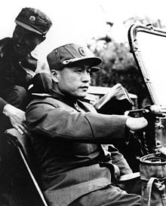
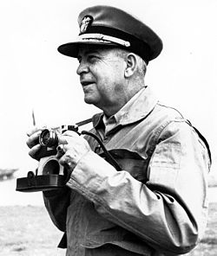
Initiative
North Korean General Nam Il
US Admiral Charles Turner Joy
Notes:
The peace talks to end the Korean War serve as an example. In August 10, 1951, US Admiral Charles Turner Joy
and North Korean General Nam Il waited in silence, staring at each other, for 2 hours and 11
minutes for the counterpart to rst suggest a path of action regarding the 38th parallel as line of
demarcation between North and South Korea (United States Department of State, 1983). Even
though most observers expected a rapid agreement on this and other issues, talks (and consequently
war) extended for more than two years. Both, the opportunistic incentives the US faced if North
Korea would have agreed to cooperate and withdraw their armed forces to the 38th parallel, and
the opportunistic incentives North Korea faced if it would have been allowed to keep its military
positions beyond the 38th parallel, partly explain the stalemate (Xia, 2006; Matray, 2011/2012).

Slide 5
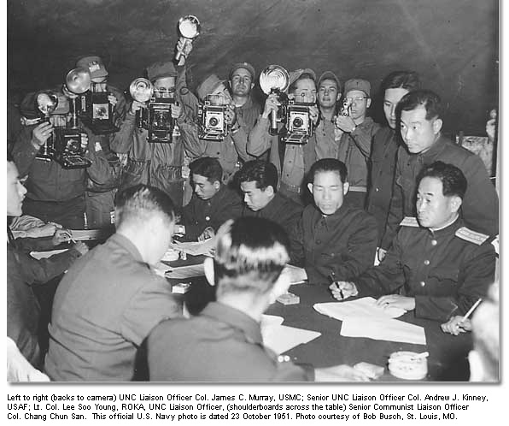
Initiative
North Korean General Nam Il
US Admiral Charles Turner Joy
2 hours and 11 minutes of silence
Notes:
The peace talks to end the Korean War serve as an example. In August 10, 1951, US Admiral Charles Turner Joy
and North Korean General Nam Il waited in silence, staring at each other, for 2 hours and 11
minutes for the counterpart to rst suggest a path of action regarding the 38th parallel as line of
demarcation between North and South Korea (United States Department of State, 1983). Even
though most observers expected a rapid agreement on this and other issues, talks (and consequently
war) extended for more than two years. Both, the opportunistic incentives the US faced if North
Korea would have agreed to cooperate and withdraw their armed forces to the 38th parallel, and
the opportunistic incentives North Korea faced if it would have been allowed to keep its military
positions beyond the 38th parallel, partly explain the stalemate (Xia, 2006; Matray, 2011/2012).

Slide 6
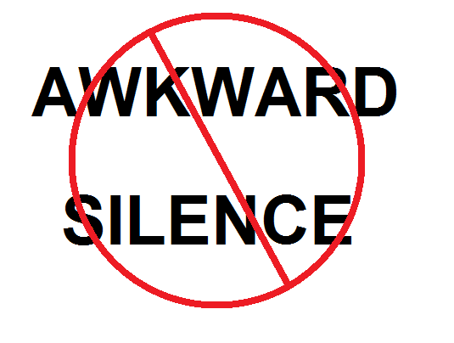
Initiative
North Korean General Nam Il
US Admiral Charles Turner Joy
Notes:
The peace talks to end the Korean War serve as an example. In August 10, 1951, US Admiral Charles Turner Joy
and North Korean General Nam Il waited in silence, staring at each other, for 2 hours and 11
minutes for the counterpart to rst suggest a path of action regarding the 38th parallel as line of
demarcation between North and South Korea (United States Department of State, 1983). Even
though most observers expected a rapid agreement on this and other issues, talks (and consequently
war) extended for more than two years. Both, the opportunistic incentives the US faced if North
Korea would have agreed to cooperate and withdraw their armed forces to the 38th parallel, and
the opportunistic incentives North Korea faced if it would have been allowed to keep its military
positions beyond the 38th parallel, partly explain the stalemate (Xia, 2006; Matray, 2011/2012).

